Slide 1

Schneiderman’s Rules

Slide 2
STRIVE FOR CONSISTENCY

Slide 3
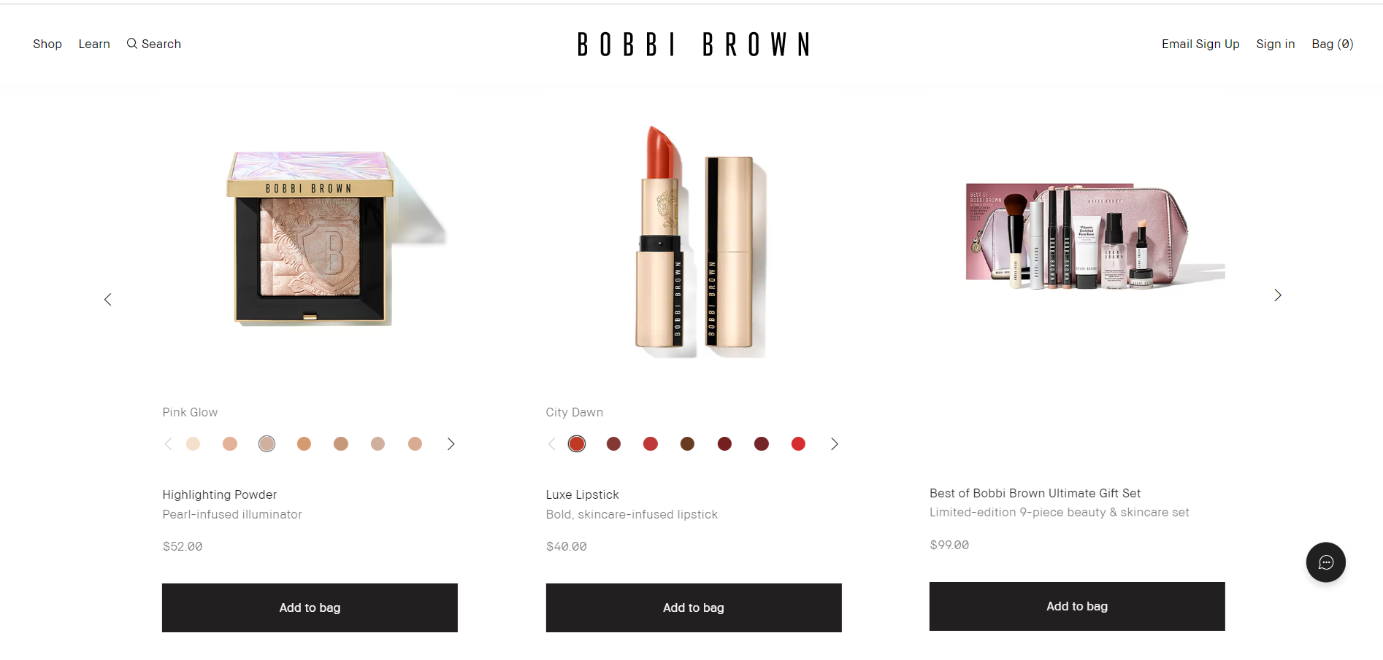
Bobbi Brown

Slide 4

M·A·C

Slide 5
2. Enable Frequent Users to Use Shortcuts

Slide 6

Bobbi Brown

Slide 7

M·A·C

Slide 8
3. Offer Informative Feedback

Slide 9
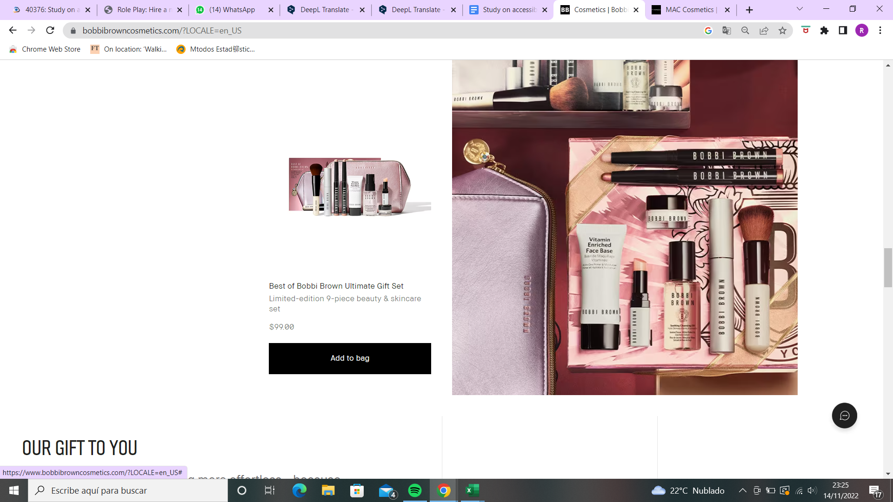
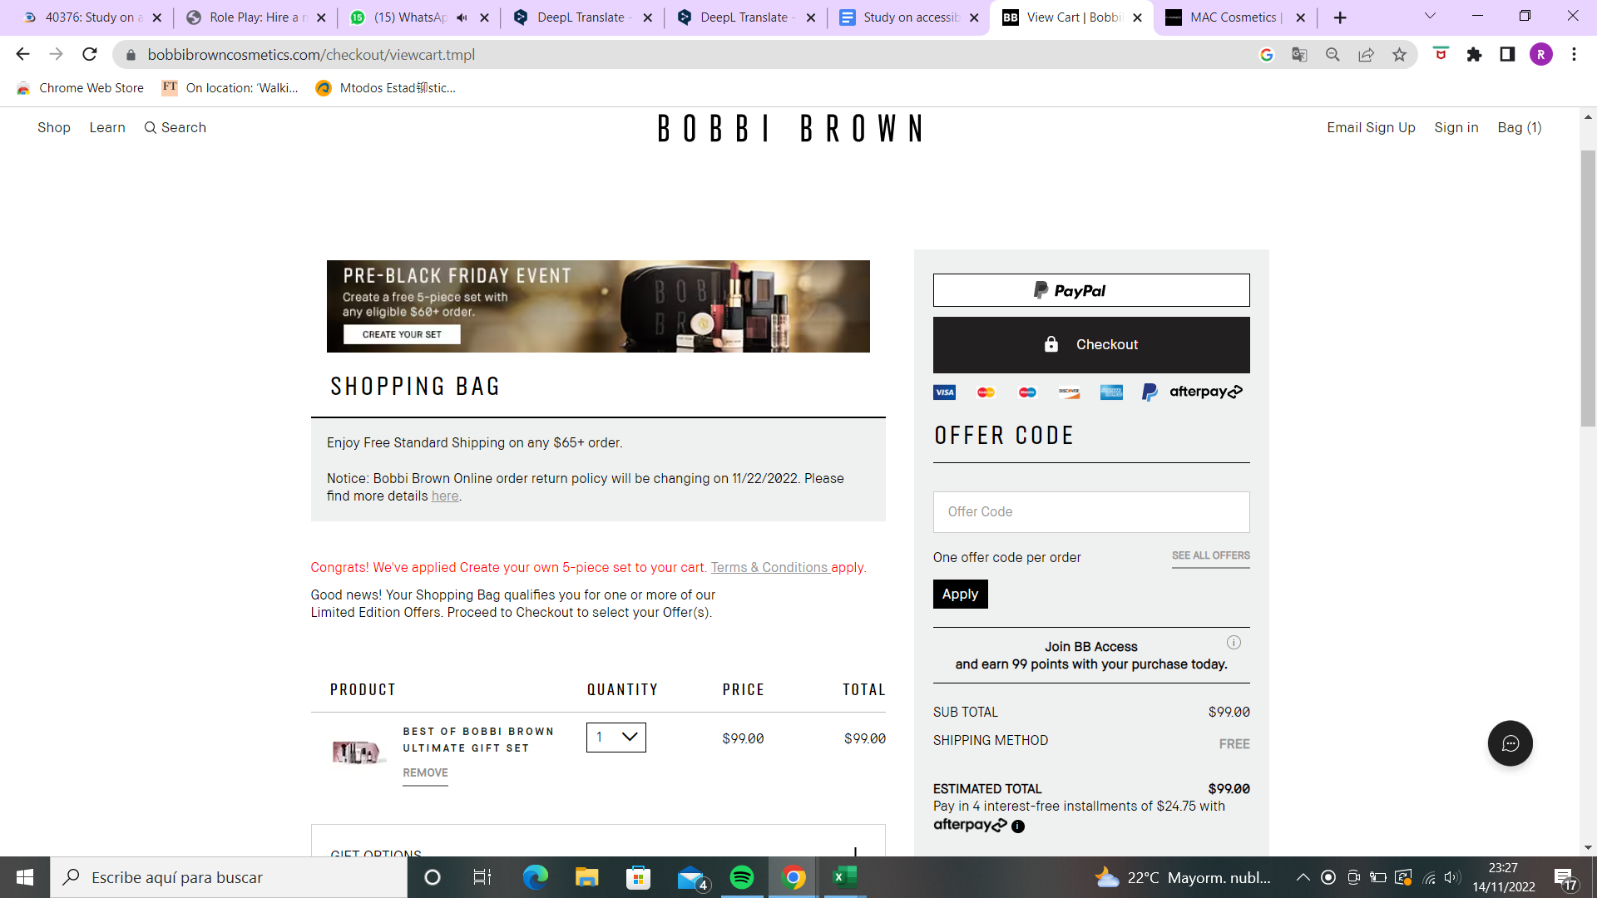
Bobbi Brown

Slide 10
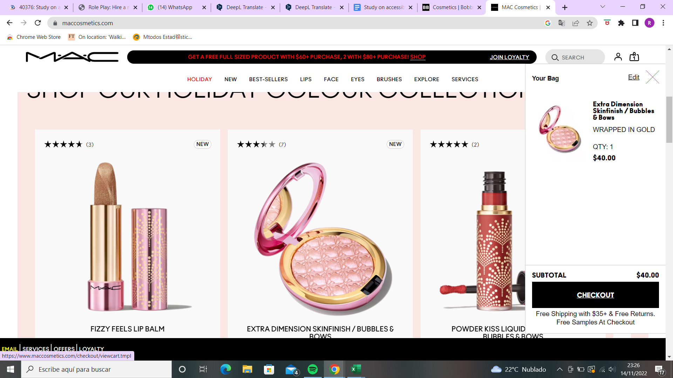
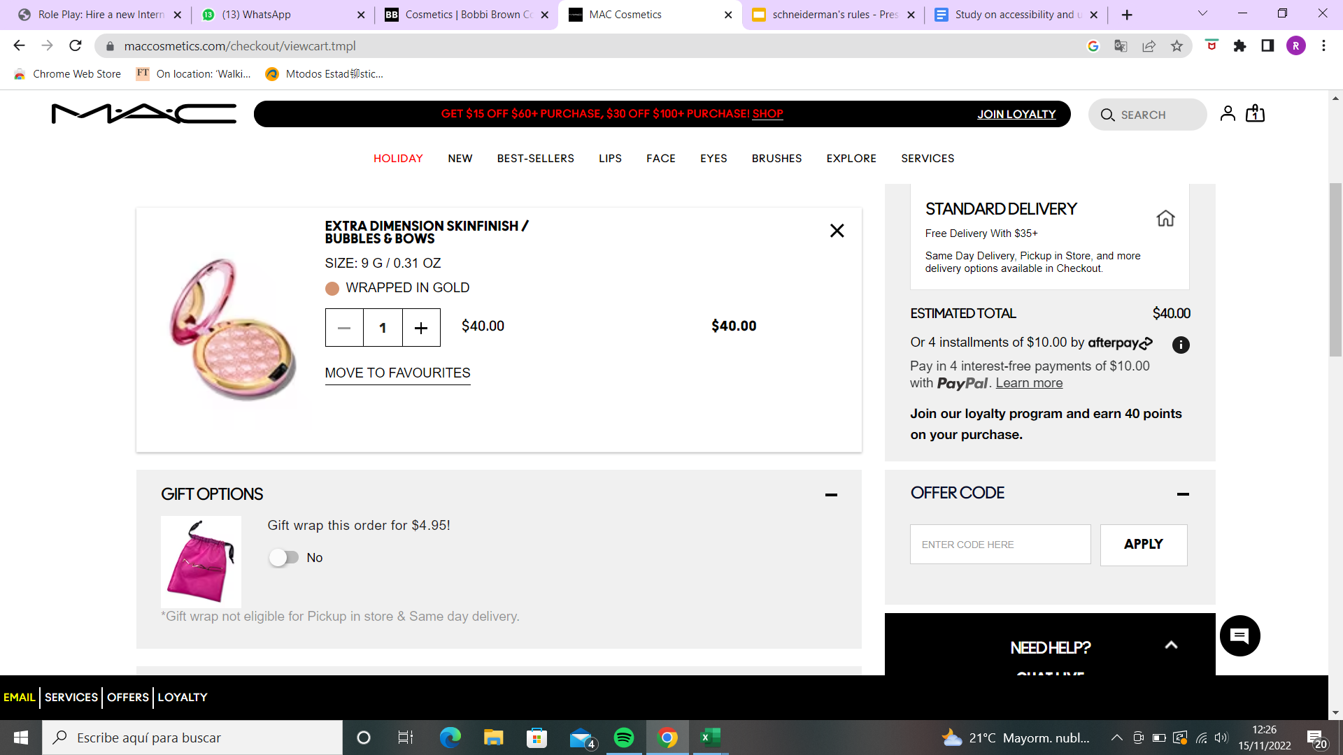
M·A·C

Slide 11
4. Design Dialog to Yield Closure

Slide 12
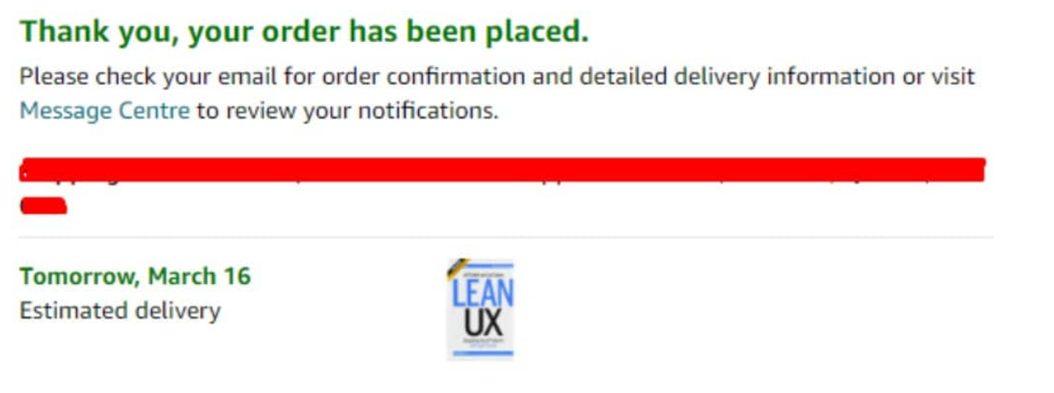
Bobbi Brown

Slide 13
5. Offer Simple Error Handling

Slide 14
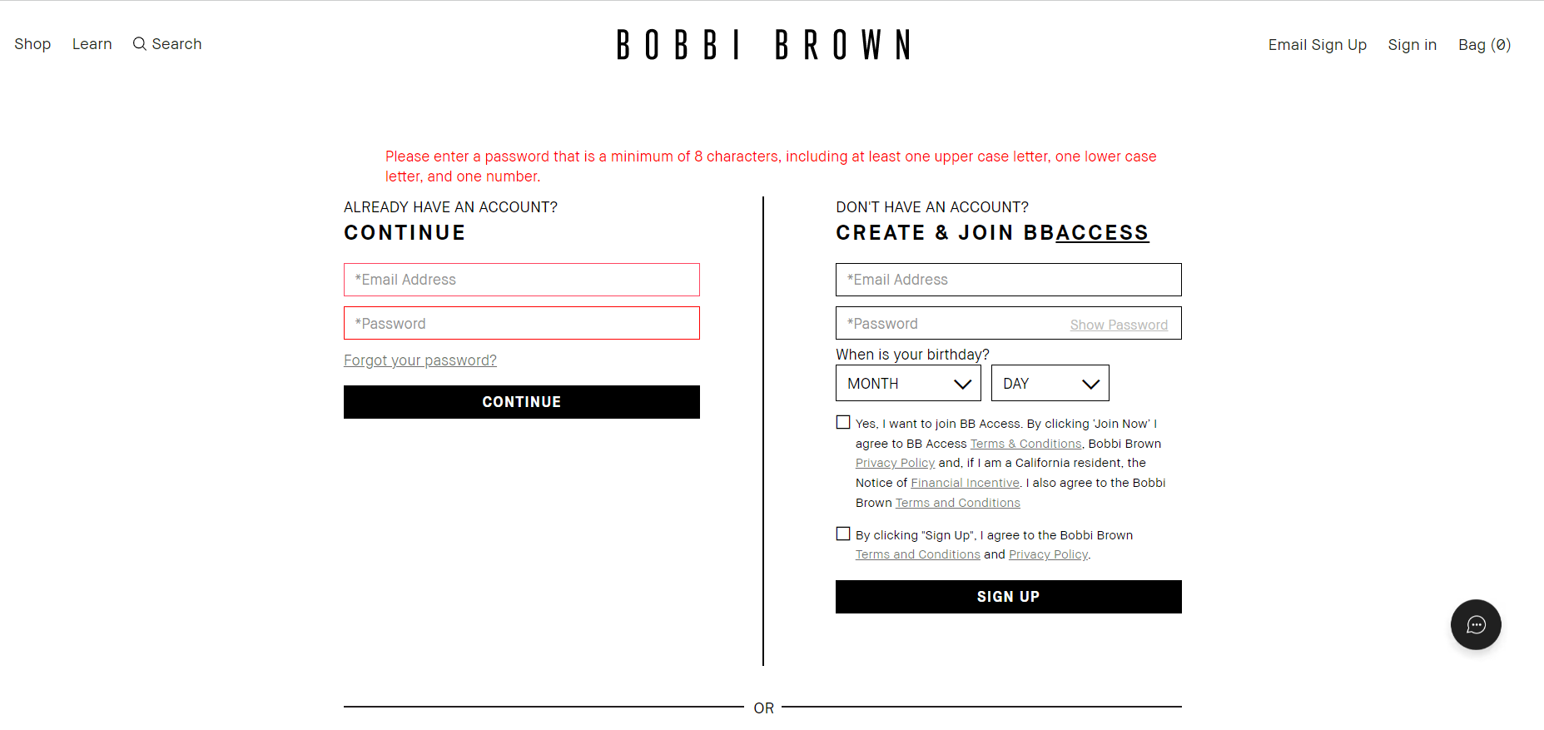
Bobbi Brown

Slide 15
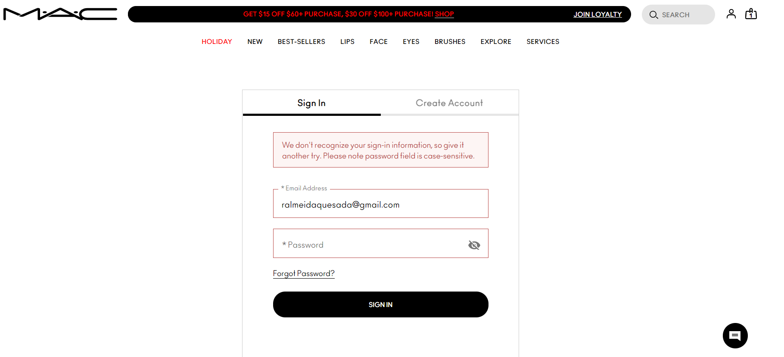
M·A·C

Slide 16
6. Permit Easy Reversal of Actions

Slide 17
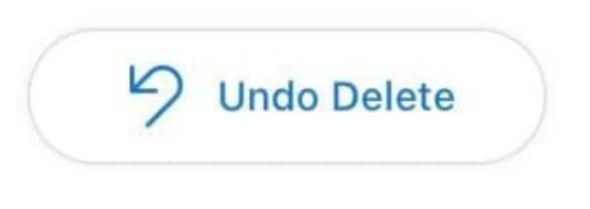

Slide 18
7. Support Internal Locus of Control

Slide 19
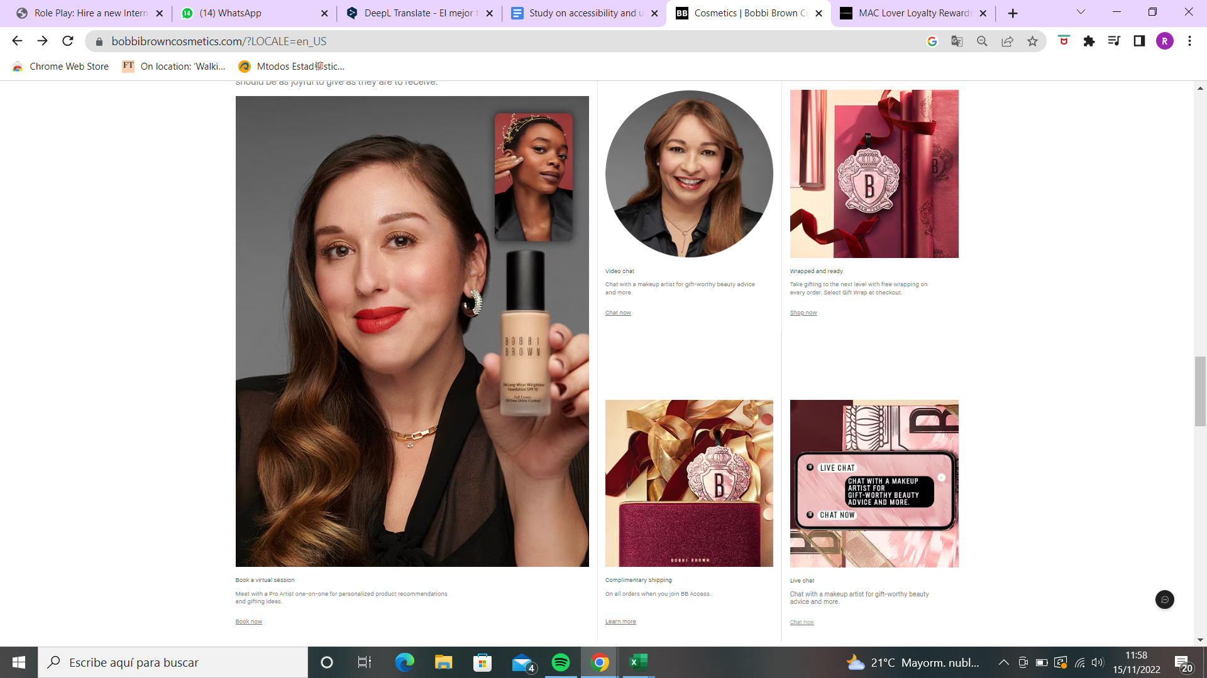
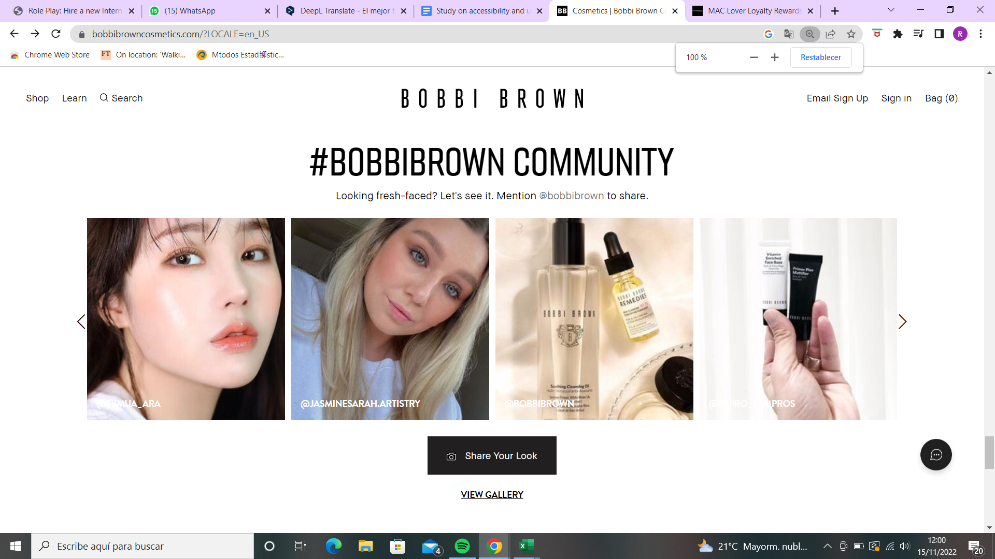
Bobbi Brown

Slide 20
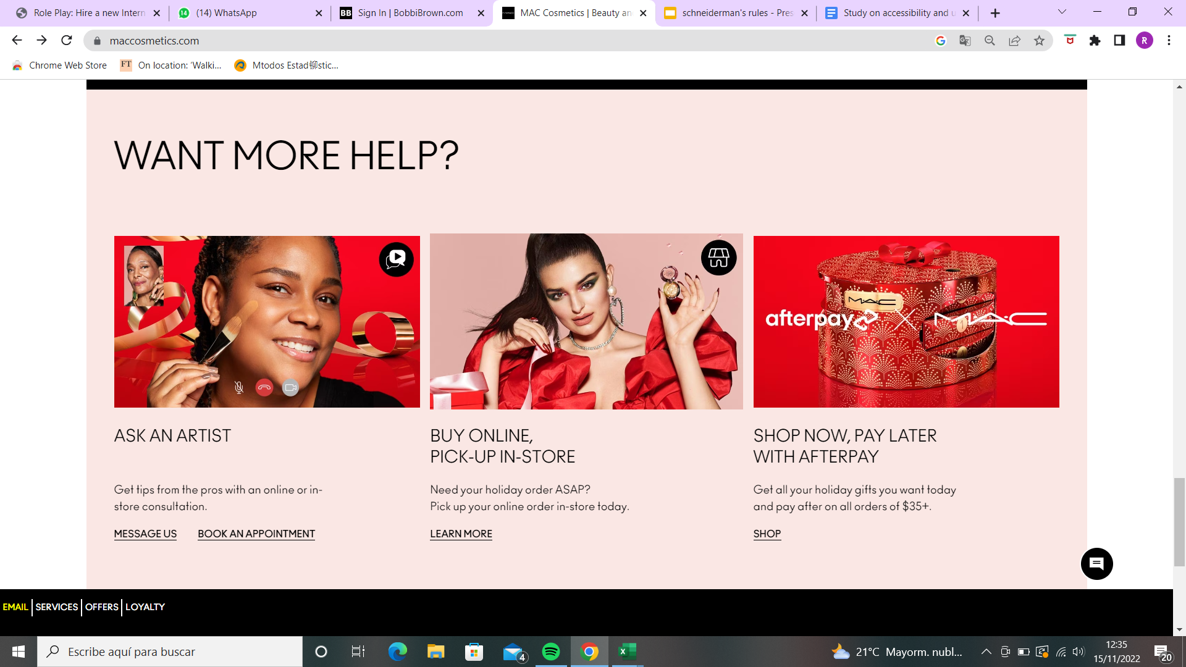

M·A·C

Slide 21
8. Reduce Short-Term Memory Load

Slide 22

Bobbi Brown

Slide 23

M·A·C

Slide 24
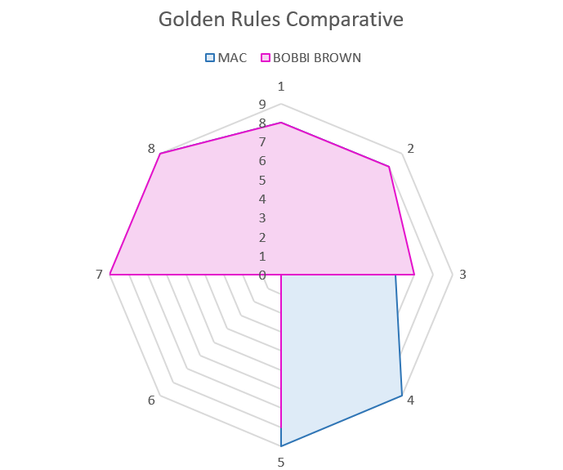

Slide 25
